Slide 1
FileIO

Slide 2
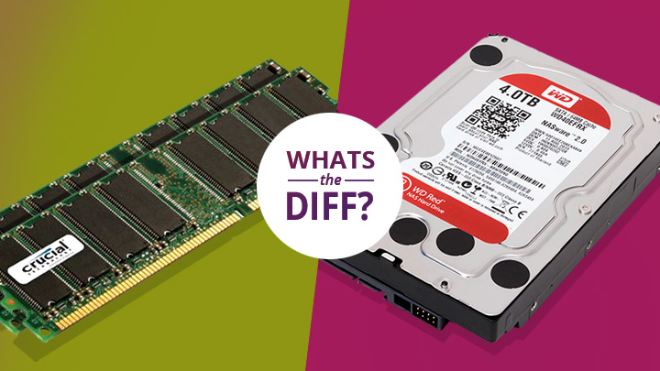
What is FileIO?
File In-Out
How do we read actual data on disc as opposed to creating and manipulating data in memory.

Slide 3
Why do we use it?
It is nice to save data sometimes
We might have data that we need to parse that came in a file
Makes learning programming so much more interesting
Especially the advanced stuff
Parsing data is useful in countless situations
This is a great way to practice parsing data

Slide 4
Warning
The most common error that you will encounter says that…
“The type or namespace could not be found……….”
using System.IO;

Slide 5
Before we start
The above code is incredibly important.
AppDomain.CurrentDomain.BaseDirectory gives the path to the executable of your program.
DON’T HARDCODE PATHS!!!
It won’t run on my machine because I have different paths than you!

Slide 6
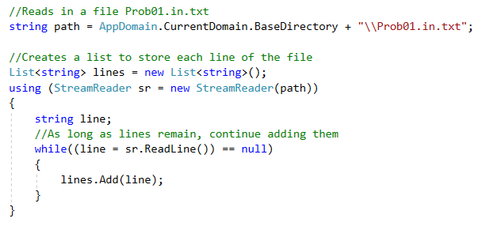
StreamReader (The I in FileIO)

Slide 7
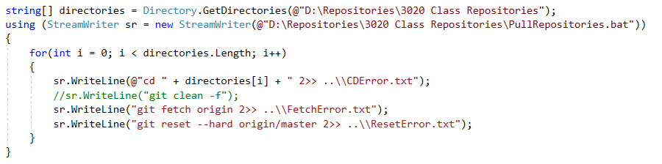
StreamWriter (The O in FileIO)

Slide 8
Searching for Files

Slide 9
Many Other Ways
https://docs.microsoft.com/en-us/dotnet/standard/io/
For the scope of this class we will only be talking about a small portion of .NETs FileIO.
Thankfully, we can do a ton of powerful stuff with just the few bits we will discuss.

